Slide 1
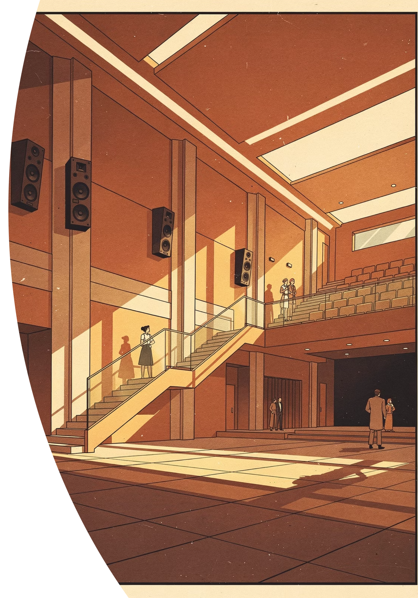


Marziani Labs™ Planar Dynamic Matryxx™ Arrays
The future of commercial audio is here — ultra-efficient, architecturally elegant, and engineered to redefine what large-scale sound looks and sounds like.

Slide 2
The Future of Commercial Audio Has Arrived
Marziani Labs™ has fundamentally redefined what's possible in commercial sound reinforcement. The Planar Dynamic Matryxx™ array isn't an incremental improvement — it's a complete architectural rethinking of how sound is generated, projected, and experienced in large-scale environments. Where conventional loudspeaker technology relies on brute-force amplification, heavy cone drivers, and complex power distribution, Marziani delivers concert-grade performance from a single standard wall outlet.
Traditional commercial audio has long been burdened by the physics of point-source speakers: diminishing SPL with distance, phase cancellation between overlapping cabinets, hot spots and dead zones that no amount of DSP can fully correct, and an ever-growing web of high-amperage cabling, racks of amplifiers, and diesel generators for touring applications. The result is a system that fights itself at every step — expensive to install, expensive to operate, and acoustically compromised by its own complexity.
Matryxx™ arrays operate on entirely different physics. By leveraging ultra-low mass (2–4 µm) Planar Dynamic drivers configured as a true plane acoustic source, Marziani produces a coherent cylindrical wave that maintains volume, clarity, and phase integrity over distances exceeding 1,000 feet. This isn't marketing language — it's a measurable acoustic phenomenon that changes the economics and performance expectations of every installation, from stadium concerts and touring rigs to permanent architectural installs in arenas, houses of worship, convention centers, and outdoor festivals.
102 dB Sensitivity
1,000+ Ft Throw
Full concert output from less than a single watt of acoustic power.
Coherent plane-source projection with virtually no decibel loss.
110V Operation
Zero Phase Cancellation
Entire rigs plug into a standard wall outlet. No dedicated circuits required.
Crystal-clear intelligibility from the front row to the back wall.

Slide 3
What Makes Matryxx™ Arrays Unique?
At the heart of every Matryxx™ array is a fundamentally different approach to acoustic transduction. Conventional loudspeakers — whether cone, compression driver, or ribbon — all share one critical limitation: they behave as point sources. Sound radiates outward in an expanding sphere, losing 6 dB of level for every doubling of distance. This inverse square law is the fundamental enemy of long-throw audio, and it's why traditional systems require so many cabinets, so much power, and so much careful aiming just to achieve uneven coverage.
Marziani's Planar Dynamic drivers use an ultra-thin (2–4 µm) membrane driven by a distributed force field, creating acoustic output that behaves as a plane source rather than a point source. The resulting wavefront is cylindrical — it expands in only one direction rather than three — meaning SPL loss with distance is dramatically reduced. The math is unambiguous: where a point source loses 6 dB per doubling of distance, a true plane source loses far less, maintaining intelligibility and impact at distances that would require a wall of conventional boxes to approach.
The sensitivity figure tells the story precisely: ~102 dB at 1W/1m. In practical terms, this means a stereo pair of Matryxx™ 100-driver arrays can fill a stadium-sized space with 100+ dB of concert-level output while drawing less acoustic power than a household light bulb. The remainder of the system's 0.2 kW total draw goes to onboard electronics and signal processing — not to fighting the inefficiencies of conventional transducer physics.
Plane-Source Physics
Traditional Point-Source
Cylindrical wave propagation maintains coherence over massive distances. Sound doesn't scatter — it travels.
Conventional cone and compression drivers radiate spherically, losing 6 dB per distance doubling and creating phase chaos when multiple units overlap.
Ultra-low mass 2–4 µm membrane drivers
Distributed force field actuation
Minimal SPL loss over distance
No inverse-square-law penalty
Heavy cone or compression drivers
Spherical wave radiation
Severe SPL loss with distance
Phase cancellation between cabinets

Slide 4
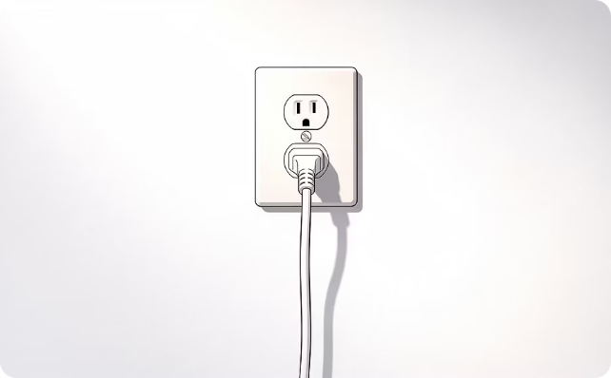
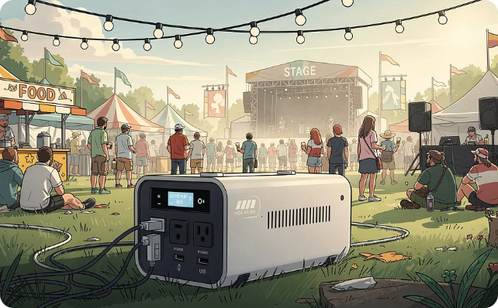
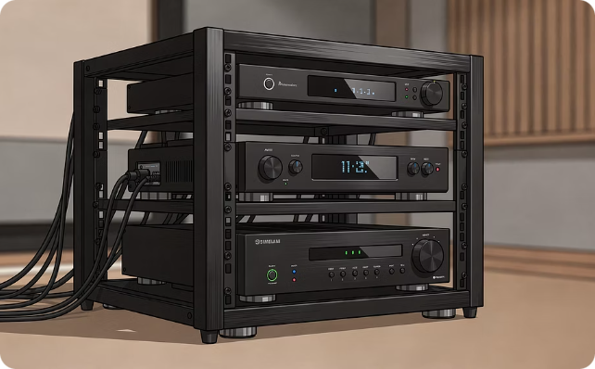
Power Efficiency: A Revolution in Audio Infrastructure
Standard 110V Wall Outlet
Off-Grid & Touring Ready
Minimal Infrastructure Footprint
An entire Matryxx™ rig draws just ~0.2 kW total. Plug your full concert system into the same outlet as a laptop. No dedicated circuits, no high-amperage panels, no electrical contractor required.
For touring and outdoor events, Marziani systems operate on existing site power or small portable lithium-ion battery stations — eliminating large diesel generators entirely and the massive cost and logistics they carry.
No racks of amplifiers. No heavy-gauge copper cable runs. No power distribution hubs. The Matryxx™ system's architectural simplicity reduces your entire signal chain to its essential core — and it shows in the install.
The financial implications of this efficiency extend far beyond the monthly utility bill. For permanent indoor installations, the elimination of dedicated high-amperage circuits and heavy-gauge copper cabling alone can represent thousands of dollars in avoided electrical contracting costs. For touring productions — where diesel generator rentals, fuel logistics, and power distribution represent a significant recurring line item — the savings compound dramatically over the course of a season. A 150-date tour running on Marziani technology versus a traditional point-source rig with generator support represents over $50,000 in avoided operational expenditure, before accounting for reduced labor, faster load-in, and eliminated rigging complexity.

Slide 5
The Financial Advantage: Real Numbers, Real Savings
The economics of the Matryxx™ system become undeniable when evaluated on total cost of ownership rather than box price. Audio system buyers who focus solely on per-cabinet cost are comparing the wrong metric — a calculation that consistently undervalues the hidden costs embedded in traditional system architectures. The true cost of a commercial or touring audio system includes electrical infrastructure, amplification, rigging, labor, power distribution, ongoing energy consumption, and — for touring applications — generator rental and fuel over the life of the tour.
Grid Scenario — Permanent Indoor Installation
Diesel Generator Scenario — Touring / Outdoor
A standard Matryxx™ rig draws approximately 0.2 kW total. Running 8 hours per day at average U.S. commercial electricity rates, annual energy costs are negligible — measured in tens of dollars, not hundreds. Compare this to a traditional 8-box point-source rig drawing 2–4 kW, and the energy savings compound year over year.
For touring productions, the generator equation is where Marziani's advantage becomes transformative. Generator rentals, fuel costs, refueling logistics, and power distribution labor are all eliminated. Small portable lithium-ion battery stations replace the need for large diesel infrastructure entirely.
No dedicated high-amperage circuits
No heavy-gauge copper cable runs
Eliminates commercial electrical contracting costs
Hundreds saved annually in energy alone
No generator rentals or fuel contracts
No power distribution labor or cabling
Operates on existing site power or battery stations
Tens of thousands saved annually on a touring schedule
$50K+
80%
Tour Savings
Labor Reduction
Avoided generator and fuel costs over a 150-date tour versus traditional point-source rigs.
Fewer cabinets, less rigging, and simplified power means dramatically lower install labor costs.
0.2 kW
10 yr
Total System Draw
Warranty
Complete concert-level rig. Same power as a laptop and a monitor.
Industry-leading coverage, unmatched by traditional manufacturers.

Slide 6

The "Zero-Distro" Advantage
When you choose Marziani, you aren't just investing in superior sound. You're eliminating the logistics, labor, and infrastructure headaches that have defined traditional commercial audio for decades. The conventional audio production workflow is built around a cascade of dependencies: high-amperage power requires specialized electrical contracting; multiple amplifier racks require dedicated rack space and ventilation; heavy cone cabinets require engineered rigging points and load calculations; distributed speaker networks require careful delay alignment and phase management. Remove any link in that chain and the whole system is compromised.
Marziani's Zero-Distro architecture breaks every link in that chain simultaneously. A stereo pair of Matryxx™ arrays replaces an entire distributed speaker grid. A single standard 110V circuit replaces a dedicated power distribution system. Onboard processing replaces racks of outboard equipment. The result isn't just simpler — it's faster to deploy, easier to maintain, more reliable in operation, and aesthetically superior in any architectural context.
For touring production managers, Zero-Distro translates directly into faster load-in and load-out, reduced truck space, fewer crew members required, and the elimination of generator logistics that have historically consumed entire production management bandwidth on outdoor events. For permanent installation specifiers, it means a system that can be installed by a significantly smaller crew in a fraction of the time, with no requirement for commercial electrical contractors to run dedicated high-amperage circuits throughout the venue.
No Heavy-Gauge Copper Cabling
No Generator Rentals or Diesel Refueling
Plug-and-Play Deployment
A complete Matryxx™ rig runs off the same wall outlet as a laptop or phone charger. From truck to front-of-house in a fraction of the time of traditional systems.
Standard low-voltage signal and power cabling is all that's required. No high-amperage runs, no conduit, no specialized electrical labor.
Touring productions run on site power or portable battery stations. Eliminate fuel logistics, generator maintenance, and power distribution labor entirely.
"With Marziani Labs, you get 100+ dB of phase-coherent sound from a single 110V wall outlet. Over a 150-date tour, that's $50,000+ you're not spending on generators and fuel — and a premium sonic experience your audience will never forget."

Slide 7

SALES ENABLEMENT
Answering the "Why Marziani?" Question
When positioned against traditional pendant or distributed point-source speaker grids, the Matryxx™ system requires a fundamental reframe of how customers evaluate audio system value. Most specifiers and venue owners approach the buying conversation anchored to familiar reference points: per-unit cost, brand recognition, and the assumption that more speakers equals better coverage. All three of these assumptions work against legacy systems when examined rigorously — and all three become powerful selling tools when the conversation is reframed around total cost of ownership, acoustic performance, and operational simplicity.
The most important reframe is the distinction between distributed point-source architecture and coherent plane-source projection. Traditional pendant and distributed speaker systems scatter dozens — sometimes hundreds — of individual cone drivers throughout a venue, relying on overlapping coverage patterns and DSP delay alignment to approximate even distribution. The result is acoustically compromised by design: overlapping wavefronts create phase cancellation, producing the "acoustic mud" effect that is the signature limitation of distributed systems in large spaces. Some audience members are over-driven; others sit in dead zones where cancellation has robbed the system of intelligibility.
Marziani's coherent plane-source architecture eliminates this problem at the physics level. A single Matryxx™ array projects a controlled cylindrical wave with consistent volume, phase integrity, and intelligibility from 10 feet to 500 feet. There are no overlapping cabinets to create cancellation, no hot spots to manage, and no dead zones to explain away to the venue owner after the install is complete.

Slide 8
OBJECTION HANDLING
Common Objections — And How to Respond
The following scripts are designed to equip Marziani sales professionals and channel partners with technically grounded, financially compelling responses to the most common objections encountered in the commercial AV, touring, and venue ownership markets. Each response is structured to first diagnose the underlying concern, then reframe it using Marziani's specific acoustic and operational advantages. Use these as conversation frameworks, not scripts — adapt language to the specific context and technical sophistication of your audience.
1
2
3
"Your arrays cost more upfront. Why pay the premium?"
"Won't multiple distributed speakers give us better coverage?"
"We're more comfortable with a legacy brand."
Diagnosis: Customer is focused on box price, not total cost of ownership.
Response: "Looking at price per box is a trap. Traditional systems require dozens of units for even coverage, plus hidden costs — electrical contracting, rigging, amplifiers, and installation labor. With Marziani, one architectural array covers the whole venue. Labor drops by 80%, hardware footprint drops to near zero, and you get a premium seamless aesthetic that looks like art, not a commercial utility. Run the full TCO and Marziani wins before the first note is played."
Diagnosis: Customer confuses speaker quantity with coverage quality.
Response: "The opposite is true. Scattered cone speakers overlap and create severe phase cancellation — 'acoustic mud.' Some zones get blasted; others can't hear. Our Planar Dynamic Matryxx™ arrays act as a coherent plane source, projecting a controlled wave with perfect intelligibility and constant volume whether you're 10 or 500 feet away. You get true immersion without chaos, and you get it with one system, not fifty."
Diagnosis: Customer is risk-averse and relies on brand recognition as a proxy for quality.
Response: "Legacy brands are tied to legacy science — heavy cones, high power needs, and 1950s acoustics. Marziani Labs delivers next-generation commercial audio: 102 dB sensitivity, stadium-level acoustics on less than a watt, and a plug into any standard outlet. We provide a massive operational advantage, innovative technology, and a 10-year warranty unmatched by traditional manufacturers. The risk is in staying with yesterday's technology."

Slide 9
Quick-Reference Battle Matrix
For rapid competitive positioning in specification reviews, procurement conversations, or side-by-side evaluations, the following matrix captures the critical performance and operational differentiators between Marziani Labs Matryxx™ arrays and conventional commercial audio systems. Share this matrix with technical decision-makers, AV specifiers, and procurement committees as a structured foundation for the broader TCO conversation. Every metric in this table represents a documented performance or operational advantage grounded in measurable physics, real-world installation data, or published acoustic specifications.
Feature / Metric
Marziani Labs Matryxx™ Arrays
Traditional Point-Source Systems
Acoustic Wave Type
Cylindrical (Plane-Source) — 1,000+ ft throw, minimal SPL loss
Spherical (Point-Source) — 6 dB loss per doubling of distance
Power Infrastructure
Ultra-efficient. 102 dB sensitivity; full concert output from standard 110V wall outlet
High-amperage circuits, dedicated power distribution, multi-kW draw
Installation Complexity
Minimal. One sleek array blankets an entire space. No specialized electrical work.
Dozens of cabinets, rigging engineers, amplifier racks, cable infrastructure
Sonic Clarity
Perfect phase coherence. Crystal-clear intelligibility everywhere in the venue
Phase cancellation between overlapping cabinets creates acoustic mud and dead zones
Touring Infrastructure
Runs on site power or portable lithium-ion battery stations. No generators required.
Large diesel generators, fuel logistics, power distro labor, and recurring rental costs
Aesthetic Profile
Sleek, architectural. Designed to complement modern venue interiors.
Bulky commercial utility appearance; difficult to integrate architecturally
Warranty
10-year coverage — industry-leading
Typically 1–3 years standard

Slide 10

Technical Specifications: Matryxx™ 100
The Matryxx™ 100 is the flagship configuration in the Marziani Labs Planar Dynamic array lineup — a 100-driver array engineered to deliver full-frequency, high-SPL performance in the most demanding commercial, touring, and large-venue applications. Every specification reflects the core design philosophy of the Matryxx™ platform: achieve maximum acoustic output with minimum power consumption, minimum infrastructure footprint, and maximum phase coherence across the entire coverage area. Custom configurations are available for specialized applications; contact Marziani Labs for project-specific consultation and system design support.
Model
Matryxx™ 100
Driver Configuration
100-driver Planar Dynamic Array
Frequency Range
40 Hz – 20 kHz
Maximum SPL (Peak)
100+ dB
Sensitivity
~102 dB @ 1W/1m
Acoustic Power Draw
<1W acoustic
Total System Power Draw
~0.2 kW (includes electronics and onboard processing)
Power Requirement
Standard 110V wall outlet
Wave Type
Cylindrical (Plane-Source)
Effective Throw Distance
1,000+ feet with minimal SPL loss
Driver Membrane Thickness
2–4 µm ultra-low mass Planar Dynamic
Warranty
10 years (industry-leading)
Pricing
Custom — contact Marziani Labs for project-specific quote
Custom configurations are available for specialized installations, touring packages, and large-venue deployments. Contact Marziani Labs for system design consultation and project-specific pricing.

Slide 11


Engineered for Those Who Demand Better
Marziani Labs™ Planar Dynamic Matryxx™ arrays are built for the specifiers, production managers, venue owners, and integrators who refuse to accept the compromises that traditional commercial audio has always required. Longer throw, perfect clarity, ultra-low power consumption, and a minimalist future-forward aesthetic — these are the standards the Matryxx™ platform was designed to meet without exception, at every seat, every night, in every venue.
No more tangled cable runs. No more generator rentals or diesel logistics. No more acoustic compromises from overlapping point sources fighting each other across the room. No more over-engineered power infrastructure consuming budget that should be invested in the experience itself. Just world-class, phase-coherent sound — from a single wall outlet — in any space on earth.
Large Commercial Installations
Touring Productions
Arenas, convention centers, houses of worship, and multipurpose venues demanding consistent, powerful sound over massive footprints.
Concert tours, festival stages, and live events where operational efficiency, fast deployment, and zero-generator operation change the economics of the entire run.
Outdoor & Festival Environments
Architectural Integrations
Sites without heavy grid infrastructure. Marziani runs on what's available — including portable battery stations — without compromise to output or coverage.
Venues where aesthetics matter as much as acoustics. Matryxx™ arrays are designed to complement modern architecture, not contradict it.

